Slide 1


Chapter 7
GATHERING DATA
ID: p. 226 - 274

Slide 2
Five key issues
Setting goals
Decide how to analyze data once collected
Identifying participants
Decide who to gather data from
Relationship with participants
Clear and professional
Informed consent when appropriate
Triangulation
Look at data from more than one perspective
Collect more than one type of data, eg qualitative from experiments and qualitative from interviews
Pilot studies
Small trial of main study
Notes:
Set the goas of the study. Goals that are set will influence the nature of the data gathering session. Examples include measuring presence in VR and gaming experiences. Once the goals have been set, you can concentrate on what data to look for what to do with it once it is gathered.
Indicate what kinds of people you want to gather data from. You may have a target group of users from which you may recruit participants for your study, this might related to the target audience for whom the application is designed. You will choose your participants, which is called sampling. You may also want to test your system with a sample population of elderly people (if they are the target audience), patients, or random sample consisting of equal distribution of males and females. Random sampling is truly random with recruitment, but stratified sampling is coming with convenience sampling or volunteer sampling of college students.
Clear and professional relationship with participants will help clarify the goals of the study, and provide pertinent instruction to the participants. One formal approach is the informed consent process. This involves in a formal document clearly identifying the purpose of the study by the data gatherer, and lists potential risks and benefits of participating in the study, details how personal details of the data provider or participant will be protected, pictures and videos will not identify the participants, especially true when children or persons with disabilities are involved. It also shows how the research will be conducted in an ethical fashon, and participants rights with respect to withdrawing from the study at anytime or having a copy of the final results of the study and paper. Experimenter coercion can cause the hawthorne effect!
Investigation of this phenomena from different perspectives: Triangulation of data – data drawn from different sources and different times, Investigator triangulation – different researchers have been used to collect data, Triangulation of theories – use of different theoretical frameworks through which to view data, Methodological triangulation – means employ different data gathering techniques.
Pilot studies, Running a small scele study before a larger main study. Test the exuipment and instruction, questions from an interview or questionnaire can be tested for comprehension and clarity, potential problems can be identified and corrected before running a study of 500 participants – use lab mates and colleagues. IMPORTANT – Everyone participating in the study cannot be in the main study, why? Because they will know more about the study and this can distort the results.

Slide 3
Data recording
Notes, audio, video, photographs can be used individually or in combination:
Notes plus photographs
Audio plus photographs
Video
Different challenges and advantages with each combination
3
Notes:
Which data gathering approach will be used will depend on the sensitivity of the situation, context, time and resources available. Choice of data recording approach will affect the level of detail collected, and how intrusive the data gathering will be.
In most cases, audio recordings, photographs, and notes will be sufficient. In others, it might also be important to collect videos of the participants, as to record in detail their behavior and intricacies of the activity and its context.
Hand written notes: the pen and paper are much less intrusive than keyboard based input. Disadvantage: notes can be difficult and tiring to type up and listen or observe participants at the same time as taking notes can be easy to loose concentration, biases creep in, handwriting from subjects can be difficult to decipher.
Audio: adv – less intrusive than video, better recording and storage of participant response, allows experimenter to better pay attention to interviewee, audio can also gather user’s affective reactions. Disadvantage – transcribing all the audio can be tedious and time consuming, you are only looking for a key nugget or anecdote of information from the participant, and will need to parse through the audio to pick it up.
Video: Can be highly intrusive to the participant, but is the best way to capture behavior data. Deciding where to fix the camera position is challenging, Deciding where to point the camera in order to capture to critical information can be challenging. Understanding the impact of the recording on participants behavior is also challenging. In the informed concent forms, you will need to highlight what methods of data collection you will be using and how you will insure privacy and personal data secure storage.

Slide 4
Interviews
Unstructured - are not directed by a script. Rich but not replicable.
Structured - are tightly scripted, often like a questionnaire. Replicable but may lack richness.
Semi-structured - guided by a script but interesting issues can be explored in more depth. Can provide a good balance between richness and replicability.
Focus groups – a group interview
Notes:
Interviews can be thought of as “conversation with a purpose.” The first three a named according to how much control the interviewer imposes on the conversation with a predetermined set of questions. The fourth involves a small group guided by a facilitator. Informal open ended interviewing is the best approach to gather first impressions, as participants could potentially feel comfortable in elaborating on what they liked and disliked with the system. However, if you want specific feedback on a feature or an experience facilitated by technology, then a more structured interview or questionnaire is preferred.
Unstructured – open ended, exploratory, conversations around a particular topic, start superficial and go into depth on the system (by probing the participant, “can you tell me a bit more.”). Adv: May provide rich data if the participant can elaborate and eplicate their impressions. Participants may mention something that the interviewer may not have thought about. Dis: unstructured interviews can be time consuming to analyze.
Structured – Questions are clearly worded, and short, and they are typically closed questions. Structured interviews work when the goal is clearly identified and are clearly understood. Replicable since they provide a carefully guided question for gathering response.
Semi-structured interviews – The interviewer may start with a pre planned set of questions, and then may probe the interviewee to say more until no new relevant information on a topic is forthcoming.
In all cases, it is important to not pre-empt an answer by phrasing a question to suggest that a particular answer is expected. “You seemed to like this use of color…” User centered methods should be used that takes into account participants cultural habits, and dos and don’t’s. Healthcare initiatives to the amish, ethnic and socio-economic issues.
Focus groups – Interviews are not only conducted with interviewer and interviewee, but also in groups, marketing research political campaign, and social science research. 3 to 10 people are involved, and the discussion is usually led by a trained facilitator. There is a preset agenda, but it is sufficiently flexible. The facilitator guides and prompts discussion and skillfully encourages quiet people to participate and stops verbose ones from dominating the discussion. All discussions are usually recorded for post-hoc analysis.

Slide 5
Interview questions
Two types:
‘closed questions’ have a predetermined answer format, e.g.. ‘yes’ or ‘no’
‘open questions’ do not have a predetermined format
Closed questions are easier to analyze
Avoid:
Long questions
Compound sentences - split them into two
Jargon and language that the interviewee may not understand
Leading questions that make assumptions e.g.. why do you like …?
Unconscious biases e.g.. gender stereotypes
Notes:
Open questions are suitable where the goal of the session is exploratory. Closed questions can only be used where the possible answers may be known in advance.
Guidelines for closed questions:
Compound sentences can be confusing, so split them into two separate questions. Aviod long questions. Eg. How do you like this smartphone app compared with previous ones that you have owned? -> How do you like this smartphone app?, “Have you owned other smartphone apps? If so, How do you like them?
Interviewees may not understand complex technical jargon or complex language and may be too embarrassed to admit.
Try to keep questions neutral, For example: Why do you like this style of interaction? This question assumes that the person does like it and will discourage some interviewees from stating their real feelings. Instead you can say, what are your impressions of this style or interaction? Or What do you like to dislike about this style of interaction?

Slide 6
Running the interview
Introduction – introduce yourself, explain the goals of the interview, reassure about the ethical issues, ask before you record, present the informed consent form.
Warm-up – make first questions easy and non-threatening.
Main body – present questions in a logical order
A cool-off period – include a few easy questions to defuse tension at the end
Closure – thank interviewee, signal the end, eg. switch recorder off.

Slide 7
Enriching the interview process
Props - devices for prompting interviewee, e.g. use a prototype, scenario

Slide 8
Questionnaires
Questions can be closed or open
Closed questions are easier to analyze, and may be distributed and analyzed by computer
Can be administered to large populations
Disseminated by paper, email and the web
Sampling can be a problem when the size of a population is unknown as is common online evaluation

Slide 9
Questionnaire design
The impact of a question can be influenced by question order. Can randomize question order.
You may need different versions of the questionnaire for different populations. Eg. Adults, elderly, children.
Provide clear instructions on how to complete the questionnaire.
Strike a balance between using white space and keeping the questionnaire compact.
Avoid very long questionnaires
Decide on whether phrases will all be positive, all negative or mixed.

Slide 10
Question and response format
‘Yes’ and ‘No’ checkboxes
Typically used for demographics, gender, age (categorized).
Rating scales
Likert scales, useful for measuring attitudes, opinions, beliefs, user satisfaction (1 strongly agree, 2 agree, 3 neutral, 4 disagree, 5 strongly disagree).
Semantic differential scales – Explores a range of bipolar attitudes about a particular item. Each pair of attitudes is represented as adjectives: Attractive _ _ _ _ _ _ _ _ _ _ Ugly
Place a cross between one of the extremes to indicate agreement.
Open-ended responses
10
Notes:
Designing a Scale:
Gather a pool of short statements about the subject to be investigated.
Decide on the scale, There are three main issues. How many points does the scale need? Should the scale be discrete or continuous? How to represent the scale?
Select items for the final questionnaire and reword as necessary to make them clear.
Run pilots with your study protocol and scale.
Semantic

Slide 11
Encouraging a good response
Make sure purpose of study is clear
Promise anonymity
Ensure questionnaire is well designed
Offer a short version for those who do not have time to complete a long questionnaire
Follow-up with emails, phone calls, letters
Provide an incentive
Notes:
In HCI research, it is nowadays common to give online questionnaires using Amazon’s Mechanical Turk. Participants may have a reasonable incentives to participate in the study.

Slide 12
Advantages of online questionnaires
Relatively easy and quick to distribute
Responses are usually received quickly
No copying and postage costs
Data can be collected in database for analysis
Time required for data analysis is reduced
Errors can be corrected easily
12

Slide 13
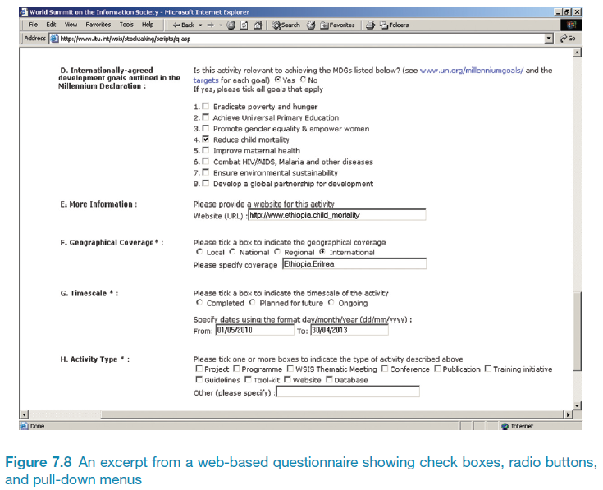
Example of an online questionnaire
13
Notes:
Design and implement an error-free interactive electronic questionnaire. It may be useful to embed feedback and pop-up help within the questionnaire.
Make sure information identifying each respondent can be captured and stored confidentially, because the same person may submit several completed surveys. You can record the IP address of the respondent, which can then be transferred directly to a database. However, this action could infringe people’s privacy and the legal situation should be checked.
Thoroughly pilot check the questionnaire. This may be achieved in four stages: the survey is reviewed by knowledgeable analysists, typical participants complete the survey using a think-aloud protocol (participants speak out what they are thinking as they are answering questions in the survey, you can judge their interpretation, comprehension and understanding of the questions); a small version of the study is attempted; a final check to catch small errors.

Slide 14
Problems with online questionnaires
Sampling is problematic if population size is unknown
Preventing individuals from responding more than once can be a problem
Individuals have also been known to change questions in email questionnaires

Slide 15
Observation
Direct observation in the field
Structuring frameworks
Degree of participation (insider or outsider)
Ethnography
Direct observation in controlled environments
Indirect observation: tracking users’ activities
Diaries
Interaction logging
Video and photographs collected remotely by drones or other equipment
15
Notes:
Figure 7.9 Mars Exploration Rover p257
Please add source: Source: Reproduced by permission of NASA Jet Propulsion Laboratory (NASA-JPL).
1. The advantage of

Slide 16
Observation
Scenarios
A usability consultant joins a group of tourists and studies how they use a wearable navigation device to walk around Stockholm and find restaurants that they are interested in. Usability consultant observes that the interface is a little difficult to use, but users find it useful and enjoyable to find restaurants nearby.
A usability consultant observes how participants perform a pre-planned task using the wearable navigation device in a usability laboratory. The task requires users to find a specific restaurant, he records the time it takes to complete the task, and records and interacitons.
What are the advantages and disadvantages of these two types of obeservations?
When might each type of observation be useful?
Scenario 1:
Observer saw how the device is used to solve real problems in the real world.
The Observer was an insider, and may not be objective in her assessment.
The data is qualitative and how useful are they?
Maybe she was having such a good time that her judgment was clouded and she missed hearing negative comments. If you wanted to reconduct the study, it would be impossible to replicate.
Scenario 2:
This type of study is easy to replicate, so users can perform the same task, specific usability problems can be identified, users’ performance can be compared, and averages for time to do the task, number of errors can be calculated.
The observer can be more objective, because she is an outsider.
Disadvantage: study is artificial and doesn’t say anything about how the device would be used in the real environment.
Notes:
What are the pros and cons of each?
When might each type of observation be useful?
Which one will you use? Depends on the goals of the studies.
The lab study is useful for examining details of the interaction styles to make sure that usability problems with the interface and button design are diagnosed and corrected.
The field study reveles how the navigation devices are used in a real-world context and how it integrates with or changes users’ behaviors.
Without these study, the developers might not have discovered the enthusiasm for the device because the reward for doing lab tasks is not as compelling as a good meal!

Slide 17
Structuring frameworks to guide observation
Three easy-to-remember parts:
The person: Who is using this technology at a particular time?
The place: Where are they using it?
The thing: What are they doing with it?
A more detailed framework (Robson, 2014):
Space: What is the physical space like and how is it laid out?
Actors: What are the names and relevant details of the people involved?
Activities: What are the actors doing and why?
Objects: What physical objects are present, such as furniture
Acts: What are specifi c individual actions?
Events: Is what you observe part of a special event?
Time: What is the sequence of events?
Goals: What are the actors trying to accomplish?
Feelings: What is the mood of the group and of individuals?
Notes:
Framework was devised for any type of observation.

Slide 18
Planning and conducting observation in the field
Decide on how involved you will be: passive observer to active participant
How to gain acceptance
How to handle sensitive topics, eg. culture, private spaces, etc.
How to collect the data:
What data to collect
What equipment to use
When to stop observing
Notes:
Degree of participation
Insider on one end and outsider on the other end. Passive observer will not take part in the study, more appropriate for laboratory studies. Insider observer is also known as participant observer, this means that he attempts, at various levels depending on the type of study, to become a member of the group he is studying. This can be difficult, because being an observer means that you need a certain amount of detachment and indifference.
2, 3, 4, one way to achieve this is to work as a team. Each person can agree to focus on different people or different parts of the context, thereby covering more ground; observation and reflection can be interweaved more easily, when you have more than one observer; and results will reflect different perspectives.
Observing is an intense and tiring activity, but it is important to check the notes and other records and to write up experiences and observations at the end of each day. If this is not done, then valuable information is lost the next day, and the next day’s events can override your impressions of the previous days impressions. Writing a diary of a blog is one way of doing this.
Be sure to separate personal opinions from observation of what happened, and suggestions of issues for further investigation.

Slide 19
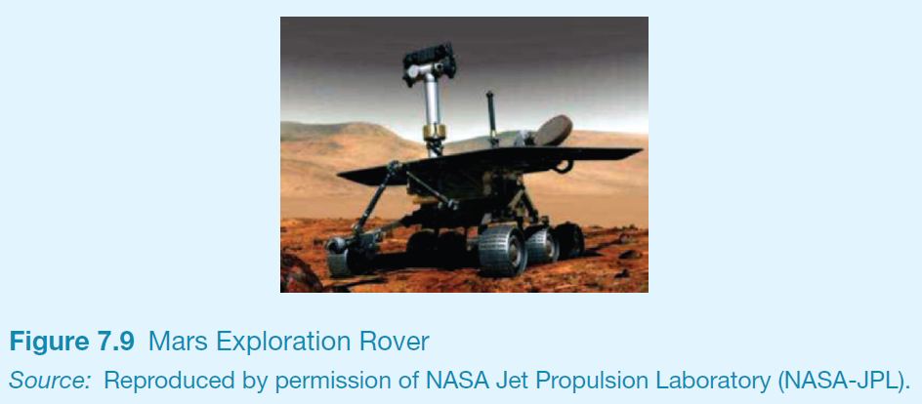
Observation
19
Notes:
The MERboard is a too to support scientists and engineers display, capture, annotate, and share information to support the operation of two Mars Exploration Rovers (MERs) on the surface of Mars. The MER acts like a human geological observer by collecting samples, analyzing them, and transmitting results back to earth. The scientists and engineers collaboratively analyze the data received, decide what to study next, create plans of actions, and send commands to the robots on the surface of Mars.
The requirements of MERboard were identified partly through ethnographic fieldwork, observation and analysis. The team of scientists and engineers ra a series of field tests that simulated the process of receiving data, analyzing it, creating plans, and transmitting them to MERs. The main problem that identified stemmed form the scientists limitations in displaying, sharing and storing the information.
The observations led to the MERboard, which contains four core applications: a whiteboard for brainstorming and sketching, a browser for displaying information from the web, the capability to display personal information and information across several screens and a file storage space linked specifically to MERboard.

Slide 20
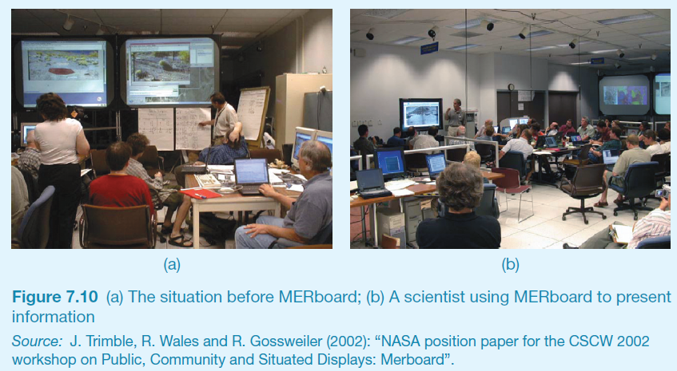
Ethnography Example
20

Slide 21
Ethnography (1)
Ethnography is a philosophy with a set of techniques that include participant observation and interviews
Ethnographers immerse themselves in the culture that they study
A researcher’s degree of participation can vary along a scale from ‘outside’ to ‘inside’
Analyzing video and data logs can be time-consuming
Collections of comments, incidents, and artifacts are made
Notes:
The key characteristic of ethnography is to observe and study a situation without imposing an apriori structure or framework upon it, and to view everything as “strange” and worthy of observation and recording. Allows you to create a detailed and nuanced understanding of people’s behavior and the use of technology.
From, Bell 2001, Lazar et al 2010, Crabtree et al 2009:
You gather data that is available – what is ordinary, what it is that people do, say, how do they work.
The data gathered has many forms – documents, notes of your own, pictures, room layout sketches.
Notes may include snippets of conversation, descriptions of rooms, meetings, what someone did, or how people react to situation.
Data gathering is opportunistic, that you collect what you can collect and make the most of the opportunities to do so.
Often, interesting phenomena do not reveal themselves immediately, but only later on, so it is important to gather as much as possible.
Initially, time should be spent getting to know people in the workspace and bond with them. It is important from the beginning that they understand why you are there, what you hope to achieve and how long you plan to be there.
Going to lunch with them, buying coffee, etc can greatly help this socialization process.
Show interest in their stories, gripes and explanations that are provided but be prepared to step back if the phone rings or someone else enters the workspace. You need to be prepared to switch in and out of their work cycles, moving into the shadows if something happens that needs the subject’s attention.
Don’t be overly keen or obtrusive – asking too many questions, taking pictures and videos from day one or getting in the way can be off-putting. Instead, listening and watching in the sidelines, and occasionally asking questions is a much better approach. When you have gained the trust and respect of the participants, then you can ask if they mind setting up a video camera, taking pictures, or using a rcorder.

Slide 22
Ethnography (2)
Co-operation of people being observed is required
Informants are useful
Data analysis is continuous
Interpretivist technique
Questions get refined as understanding grows
Reports usually contain examples
22

Slide 23
Observations and materials that might be collected (Crabtree, 2007)
Activity or job descriptions.
Rules and procedures that govern particular activities.
Descriptions of activities observed.
Recordings of the talk taking place between parties.
Informal interviews with participants explaining the detail of observed activities.
Diagrams of the physical layout, including the position of artifacts.
Other information collected when observing activities:
Photographs of artifacts (documents, diagrams, forms, computers, etc.)
Videos of artifacts.
Descriptions of artifacts.
Workflow diagrams showing the sequential order of tasks.
Process maps showing connections between activities.
23

Slide 24
Online Ethnography
Virtual, Online, Netnography
Online and offline activity
Interaction online differs from face-to-face
Virtual worlds have a persistence that physical worlds do not have
Ethical considerations and presentation of results are different
24
Notes:
online is very different than interactions in a face-to-face setting. Communication in person in face to face is richer (gestures, facial expressions, tone of voice) than online communication, and anonymity is more easily achieved when communicating online.
Virtual worlds have a persistence, due to regular archiving, that does not typically occur in face-to-face situations. This makes characteristics of the communication different, which often includes how an ethnographer introduces herself to the community, how she acts within the community, and how she reports her findings.
For large social spaces, like facebook, there are different ethical issues to consider. It is probably unrealistic to ask everyone using the digital media to sign an informed consent form, yet you do need to make sure that participants understands your involvement in the study and the purpose of the study.
Presentation of results will need to be modified too. Quotes from participants in the community, even if it is anonymized in the report, can easily be attributed by a simple search of the community archive or the IP address of the sender, so care is needed to protect the privacy.

Slide 25
Observation in a controlled environment
Direct observation
Think aloud techniques
Indirect observation – tracking users’ activities
Diaries
Interaction logs
Web analytics
Video, audio, photos, notes are used to capture data in both types of observations
25
Notes:
Controlled studies can be done in a laboratory outside the organization of the users or purpose-built usability laboratory can be build on site, like schools and command and control centers. Takes on a formal characteristic, and users are likely to feel apprehensive.
Therefore it is good to prepare a script to guide how the participants will be greeted, be told the goals of the study, and how long it will last and their rights. Use of script ensures that the participant is treated in exactly the same way time and time again.
Same data recording techniques that we have talked about before are used here too, however the goal is different. In the laboratory setting, the emphasis is on the details of what individuals do, while in the field the context is important and the focus is on how people interact with each other, the technology and their environment.
The arrangement of equipment of with respect to the participant is important, in a controlled study because details of the person’s activities need to be captured. One camera might record facial expression, antother might focus on mouse and keyboard activities, anther may capture body language. The stream of data from these cameras is fed into a video editing and analysis tool where it is coordinated, time-stamped and annotated.
Think Aloud Technique: Ask participants to say what is going on in their head, as they are performing the task! In the process strategies become self-evident.
- Key idea here is that the observer does not know what is in the participant’s head. And can only guess what they see. Observations in the field should not be intrusive, as this will disturb the very context in which you are collecting the data, so asking questions to participants has to be limited. However, in a controlled study, the observer can afford to be a little more intrusive, The think-aloud technique is a useful way of understanding what is going on a person’s head.

Slide 26
Web analytics
A system of tools and techniques for optimizing web usage by:
Measuring,
Collecting,
Analyzing, and
Reporting web data
Typically focus on the number of web visitors and page views.
26
Notes:
Web analytics can help gauge traffic and popularity trends by providing information about the number of website visitors and number of page views.
Analytics are used in business and companies measure the result of print or media advertising campaigns by estimating how traffic to a site changes after launching a campaign.
Web analytics used by website owners to measure visitor behavior and the performance of their website in a commercial context. Data is compared against key performance indicators and used to improve a website or marketing campign. (tools like statcounter.com is free to keep a track of number of visitors, their IP, time spent on the page, the number of times visited, and various sub-pages visited).
Also, quantitative metrics such as number of button clicks, downloads, emails traffic and hyperlink access can also be logged.

Slide 27
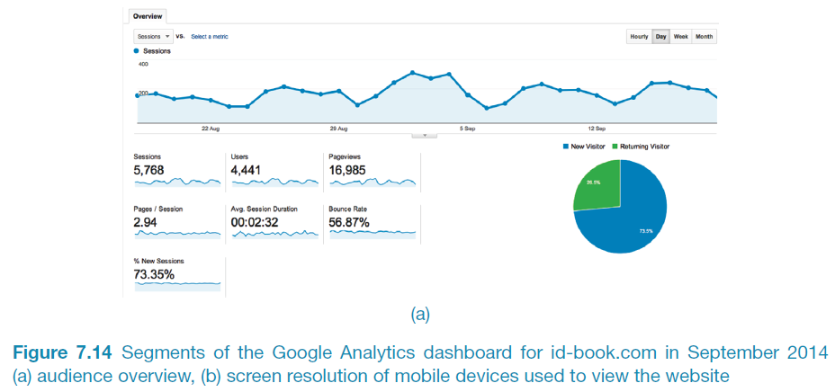
A section of Google analytics dashboard for id-book.com
27
Notes:
Google analytics is the most widely used on-site web analytics and statistics service, used by over 50% of the 10,000 most popular websites. The tool is designed to help Internet marketers and small business owners understand website traffic patterns, sources, and behaviors. The service tracks visitors from referring sites, search engines, social networks, and user visits, and tracks email marketing, pay-per-click networks, and display advertising.

Slide 28
Choosing and combining techniques
Depends on the:
Focus of the study
Participants involved
Nature of the technique(s)
Resources available
Time available
28

Slide 29
Summary
Data gathering sessions should have clear goals.
An informed consent may be needed.
Five key issues of data gathering are: goals, choosing participants, triangulation, participant relationship, pilot.
Data may be recorded using handwritten notes, audio or video recording, a camera, or any combination of these.
Interviews may be structured, semi-structured or unstructured
Focus groups are group interviews
Questionnaires may be on paper, online or telephone
Observation may be direct or indirect, in the field or in controlled settings.
Techniques can be combined depending on the study focus, participants, nature of technique, available resources and time.
29

